Slide 1
Cross-modal and Multimodal Data Intelligence
Extracting Knowledge from Large Datasets: Multimodal Approach
Goran Gvozden, PhD

Slide 2
Course/Lecture Overview
Data Analytics definition and overview
Importance of Big Data and Real world applications
Large datasets and Visual Data Intelligence
Multimodal Approach
Tools, platforms and frameworks
Business and technology landscapes

Slide 3
Course/Lecture goals
Define data analytics concepts
Acquire, preprocess, analyze large datasets
Apply techniques to extract information and knowledge from large datasets
Importance of multimodal approach in knowledge extraction
Define vector stores and databases
Acquire, preprocess, analyze and understand visual datasets
Solve basic problems related to extraction of content features
Analyze multimodal (text, audio, image, video) data to provide insightful reports

Slide 4

Data Analytics
Data represents information in digital form that can be transmitted, processed, analyzed.
Data analytics is the process of examining data sets in order to draw conclusions about the information they contain with the aid of specialized systems and software.
Data and analytics is the management of data for all uses (operational and analytical) and the analysis of data to drive business processes and improve business outcomes through more effective decision making and enhanced customer experiences.

Slide 5
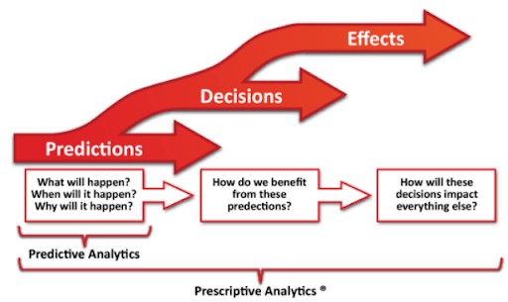
Data Analytics Types
Descriptive - What happened?
Diagnostic - Why did this happen?
Predictive - What might happen in the future?
Prescriptive - What should we do next?

Slide 6
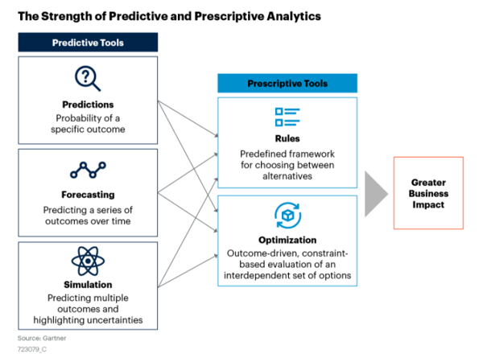
Predictive vs Prescriptive Analytics
Predictive Analytics
Predicts future events based on data
Use Cases: Churn prevention, fraud detection, demand forecasting
Example: Identifying potential customer churn
Example: Forecast inventory and delivery times for different products and locations
Prescriptive Analytics
Suggests actions to achieve desired outcomes
More actionable, builds on predictive insights
Example: Creating targeted campaigns to retain customers. Identify the customers who are most likely to churn and suggest the optimal marketing campaigns or incentives to retain them
Example: Optimize supply chain operations by recommending the best suppliers, routes and schedules to minimize the costs and risks

Slide 7
Big Data Analytics Drivers

Slide 8
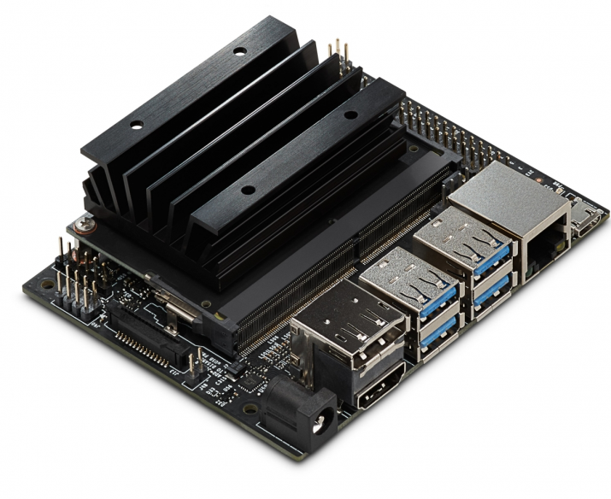
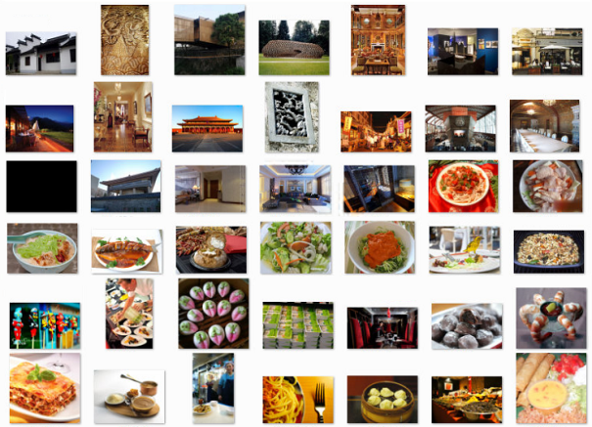
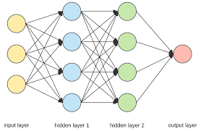
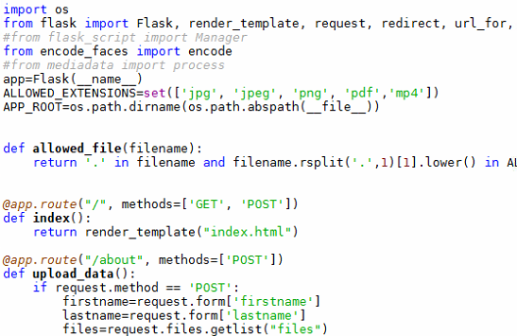
Big Data Analytics Drivers
Text/Audio/Image/Video Big Data
Processing Power
Advanced
Algorithms

Slide 9







Big Data Analytics Drivers
Ideas
Talents
AI
Tools
Computing power
Advanced algorithms
Big data

Slide 10
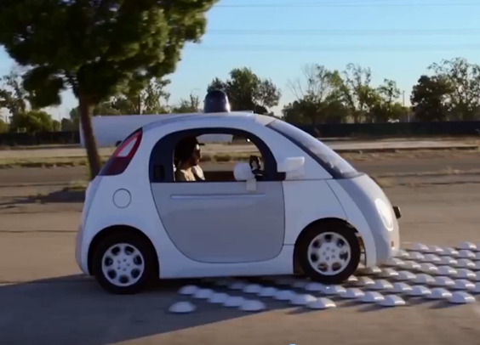
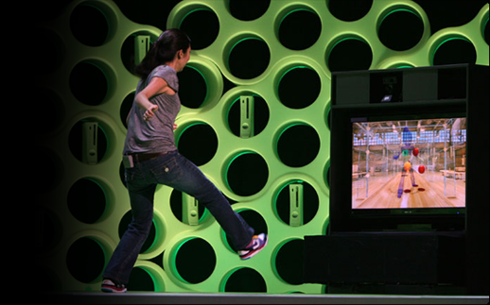
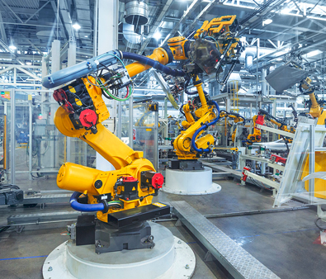

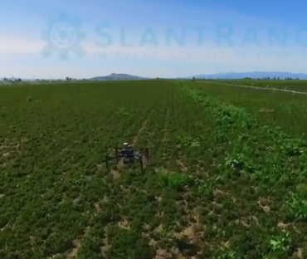
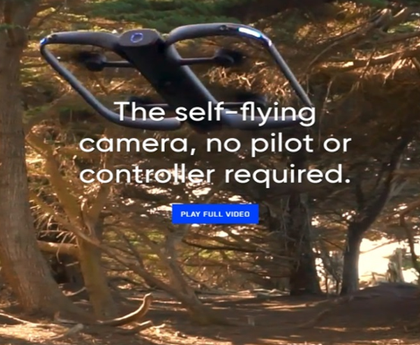
Big Data Analytics Drivers
Extract meaningful information to make decisions or take actions based on extracted information
Ability to acquire and apply knowledge and skills
Collection of information that can translate potential into social and economic value
Automotive
Gaming
Automation
Healthcare
Agriculture
Sports

Slide 11
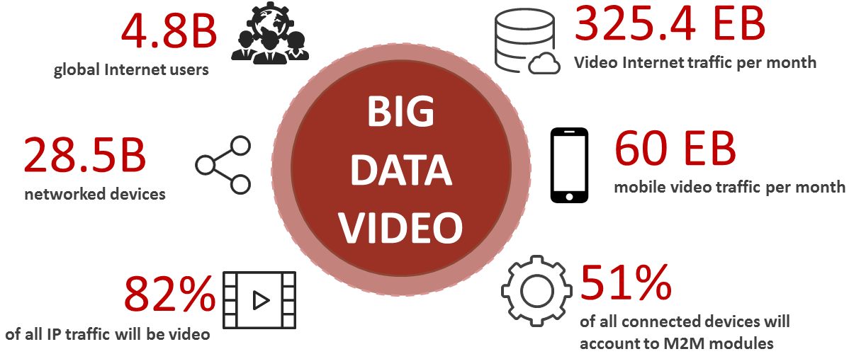
Image and Video – Really Big Data
Source: Cisco VNI index

Slide 12
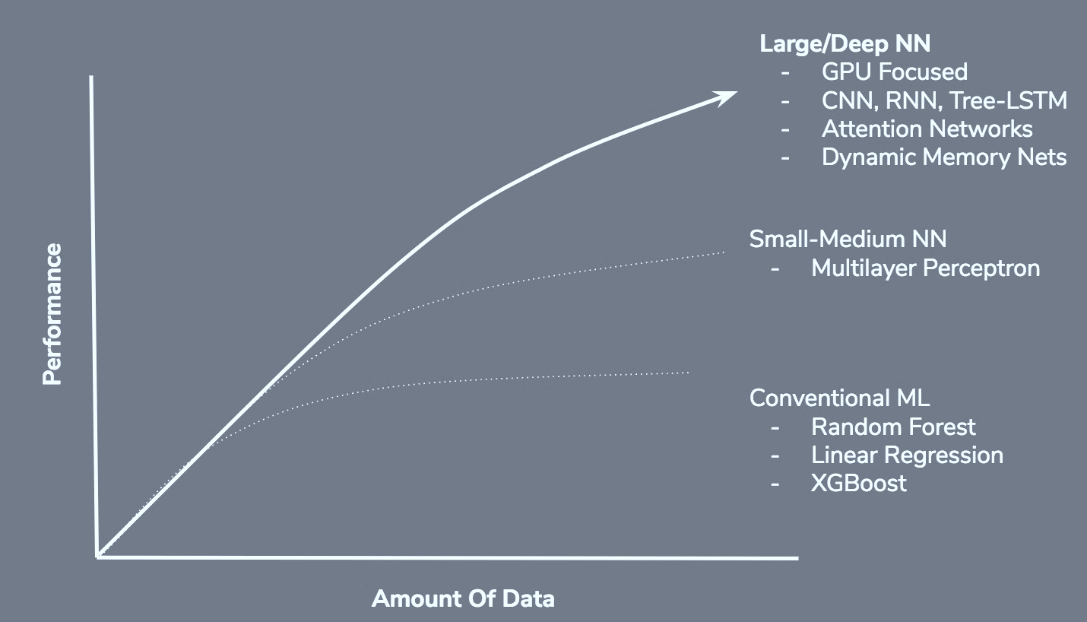


Big Data Importance

Slide 13
Key Factors Fueling Big Data Analytics
Data Explosion and Diversity
Unprecedented growth in data from digital platforms, IoT and social media in various forms (structured, unstructured).
Technological Advancements
Developments in processing (Hadoop, Spark), storage (declining costs, cloud solutions) and AI/machine learning for enhanced analysis capabilities.
Business and Market Demand
Competitive advantage through data-driven strategies, personalization in marketing and real-time decision-making in critical sectors.
Regulatory and Community Influence
Government policies on data sharing/privacy, proliferation of open-source tools, and growing data science education and skills.
Integration with Emerging Technologies
Synergies with IoT, blockchain, augmented reality, driving innovation and new applications across industries.

Slide 14
Big Data Analytics powered Foundation models

Slide 15
Introduction to Foundation Models
Definition
Foundation model is a type of large-scale artificial intelligence (AI) model that has been pre-trained on vast amounts of data and can be adapted or fine-tuned for a wide variety of tasks and applications.
Large-Scale Training
Foundation models are trained on massive datasets, often encompassing a broad range of topics, languages and formats
Versatility
Due to their comprehensive training, foundation models can be adapted to a multitude of tasks, including but not limited to language understanding, image recognition or image/art generation
Examples
GPT-3 (Generative Pre-trained Transformer 3) for language tasks, DALL-E for image generation, and BERT (Bidirectional Encoder Representations from Transformers) for understanding the context

Slide 16
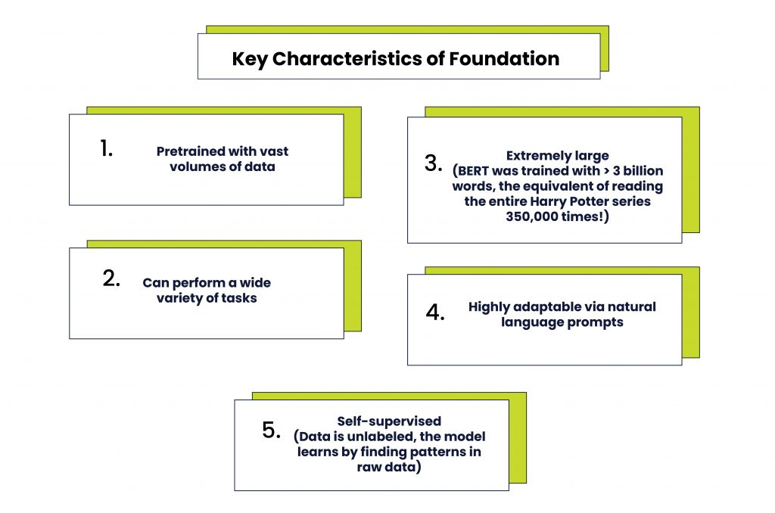
Utilizing Big Data to build foundation models
Big Data Significance
Essential for training and refining models.
Data Sources Variety
Web content, social media, literature, news and multimedia.
Pattern and Trend Analysis
Extracting insights from structured and unstructured data.
Volume and Diversity
Handling large volumes of varied data types.
Enhancing Model Robustness
Improving accuracy and applicability through diverse data.

Slide 17
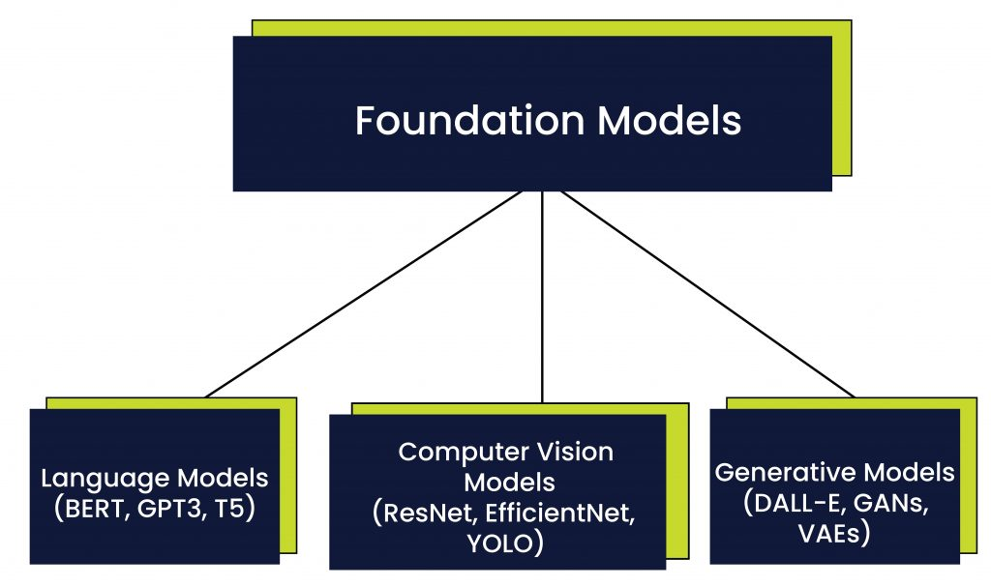
Types of Foundation Models

Slide 18
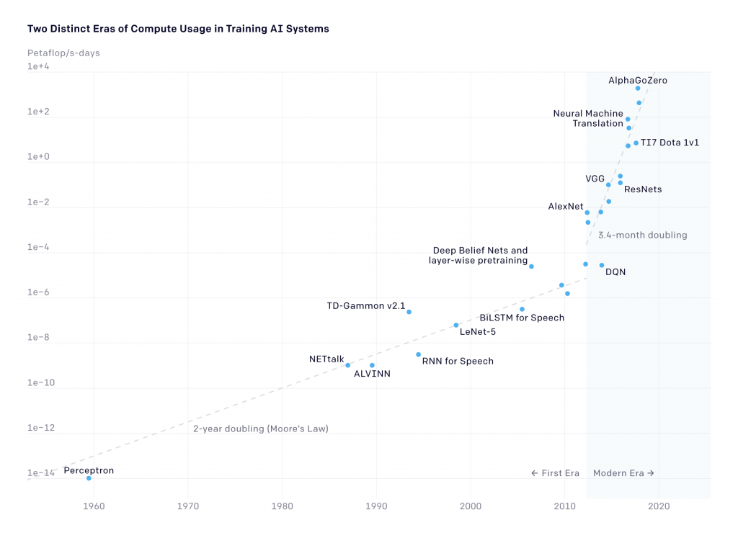
Introduction to Foundation Models
Defining Foundation Models
Large-scale, pre-trained models adaptable to various applications.
Self-Supervised Learning
Learning from unlabeled data without human intervention.
Impact Across Domains
Transforming NLP, computer vision and speech recognition.
Transformer Models
Specialized foundaton models using attention mechanisms.
Attention Mechanisms
Enhancing focus on relevant input and output aspects.

Slide 19
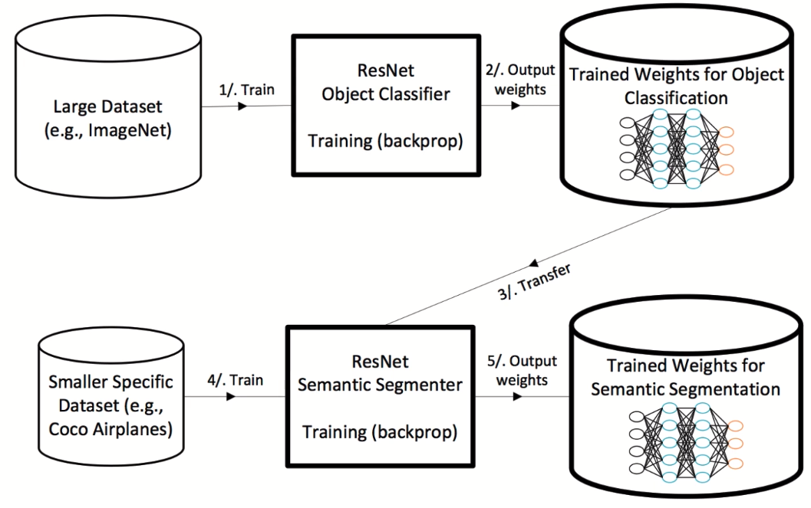
Transfer learning
Source: Microsoft

Slide 20
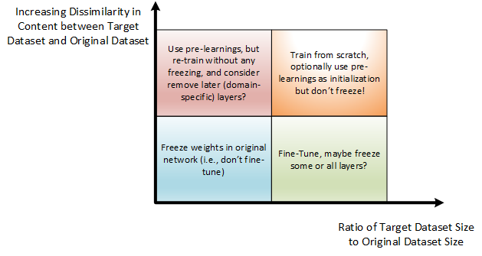
Transfer learning
Source: Microsoft

Slide 21
Learning General Representations
Universal Representation Learning
Capturing common features across modalities.
Application Versatility
Adaptable to sentiment analysis, QA, text generation.
Language and Vision Synergy
Integrating NLP and computer vision capabilities.
Speech Recognition Advancements
Improving accuracy and contextual understanding.
Domain Transferability
Applying learned models to new tasks and industries.

Slide 22
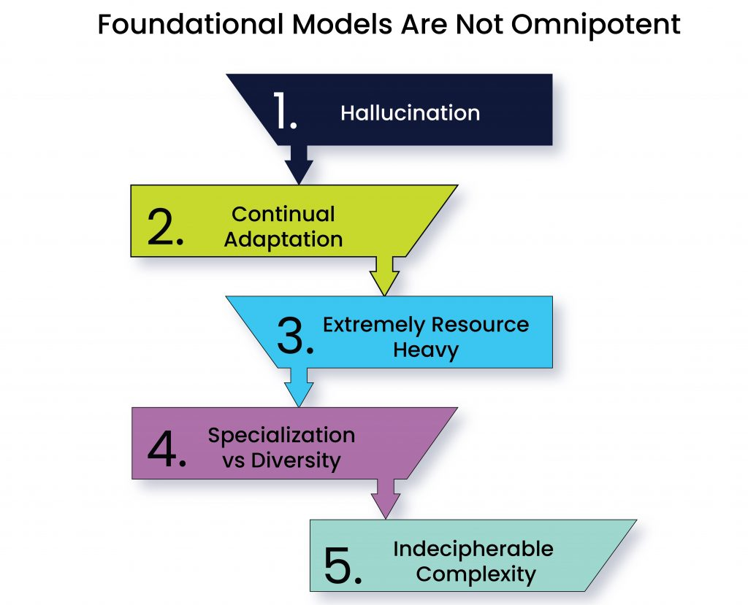
Limitations

Slide 23
Highway to Matrix

Slide 24
Introduction to Multimodal Deep Learning
Human Senses as Inspiration
AI aims to mimic the human brain's ability to process multiple senses simultaneously.
The Concept of Modalities
Understanding how different forms of data (images, audio, text, etc.) are integrated.
Multimodal Neural Networks
Mimicking the human brain's processing of multimodal inputs.
Importance in AI
Advancing AI to interpret and reason across various modalities.

Slide 25
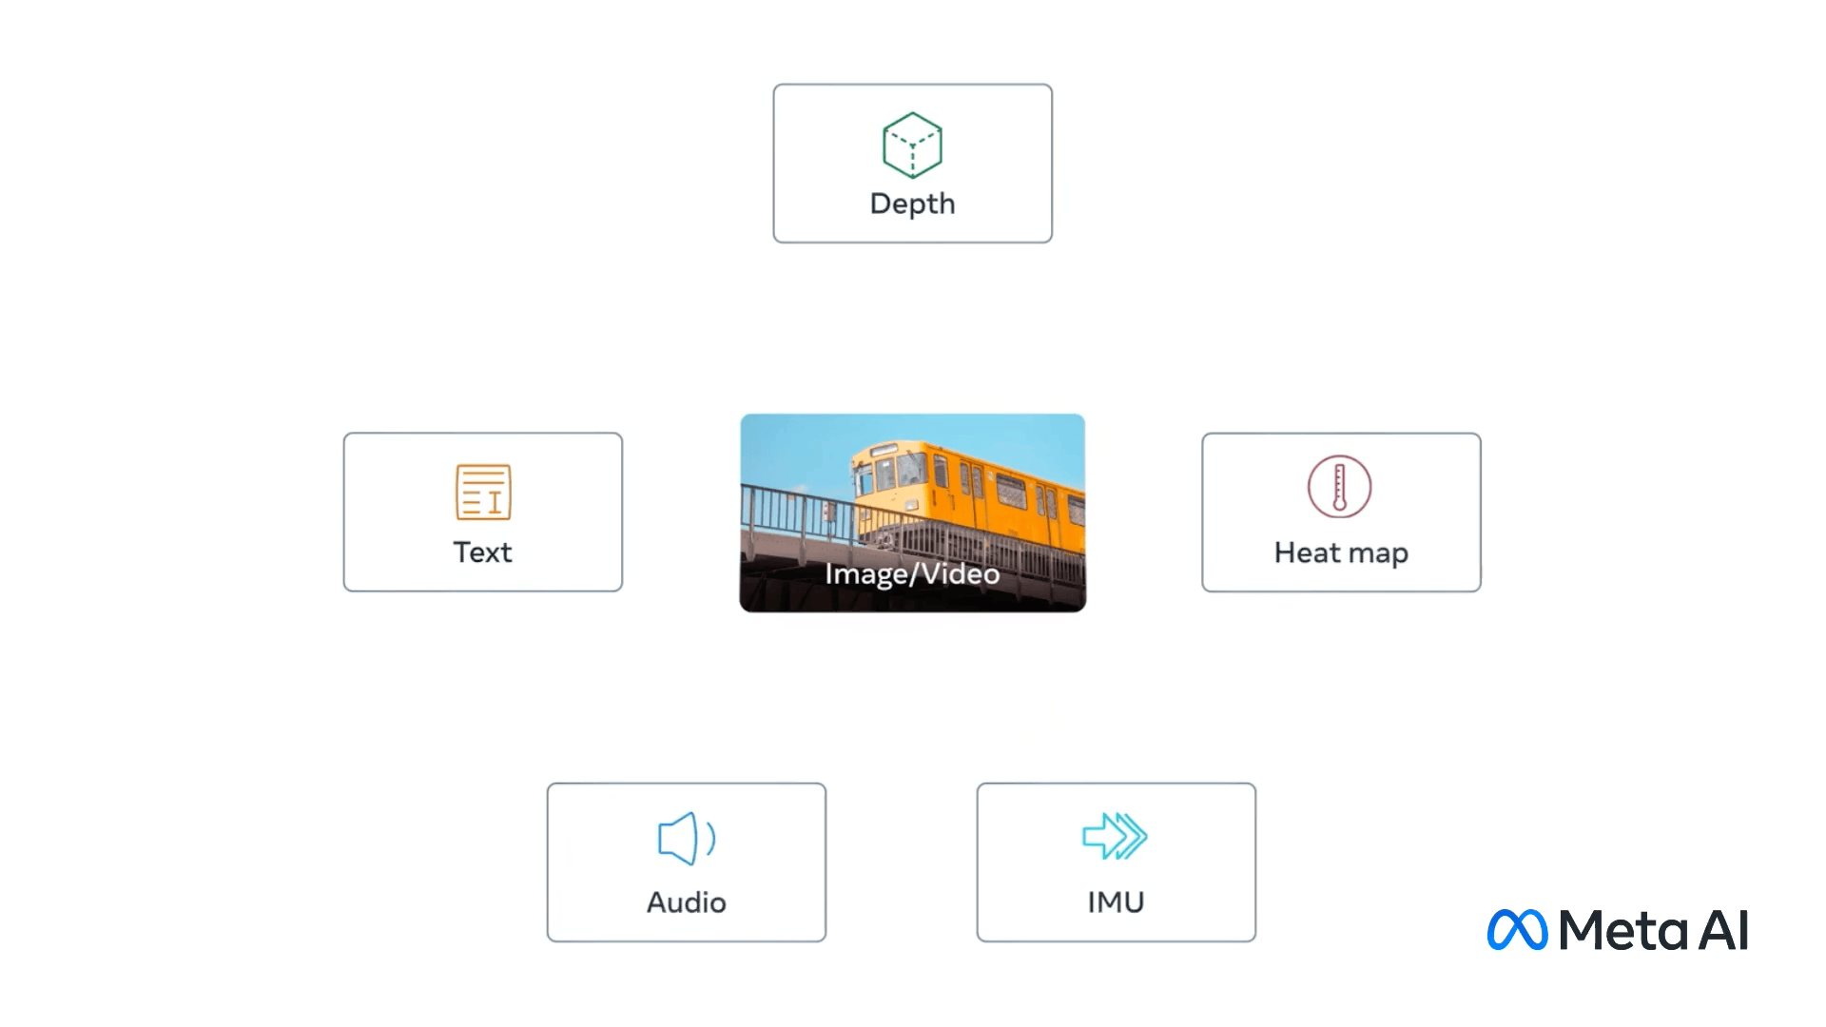
Multimodal AI
Definition:
Multimodal AI involves the integration and processing of data from multiple different modes or types.
These modes can include text, images, video, audio, sensory data, etc.

Slide 26
What is Multimodal Deep Learning?
Definition
Combining different types of data to enhance learning models.
Beyond Unimodal Models
Overcoming limitations of single-modality models.
Enriched Comprehension
Gaining deeper understanding by integrating visual, auditory, and textual data.
Examples
Emotion recognition using both visual and auditory cues.
Significance
Represents a significant leap in mimicking human-like processing.

Slide 27
Multimodal AI
Purpose:
The goal is to create systems that can understand and interpret complex scenarios or datasets that include different types of data (analyze a news article by considering the text, images and videos together

Slide 28
Multimodal AI
Complexity:
These systems must be capable of understanding the nuances and relationships between different types of data.
For instance, recognizing that a certain image in an article is directly relevant to a specific paragraph in the text.

Slide 29
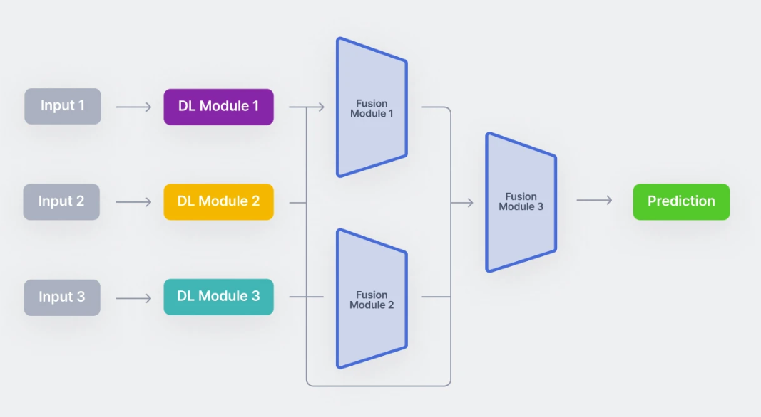
How Multimodal Learning Works
Encoding
Creating meaningful representations from each modality.
Fusion Techniques
Combining features from different modalities.
Classification Models
Utilizing the fused data for predictions.
Importance of Architecture
The role of unimodal encoders and fusion networks.
End-to-End Workflow
From individual modalities to combined interpretation.

Slide 30
Architecture
Unimodal encoders that encode individual modalities. Usually, one for each input modality.
A fusion network that combines the features extracted from each input modality, during the encoding phase.
A classifier that accepts the fused data and makes predictions.

Slide 31
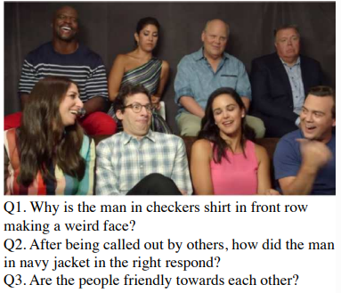
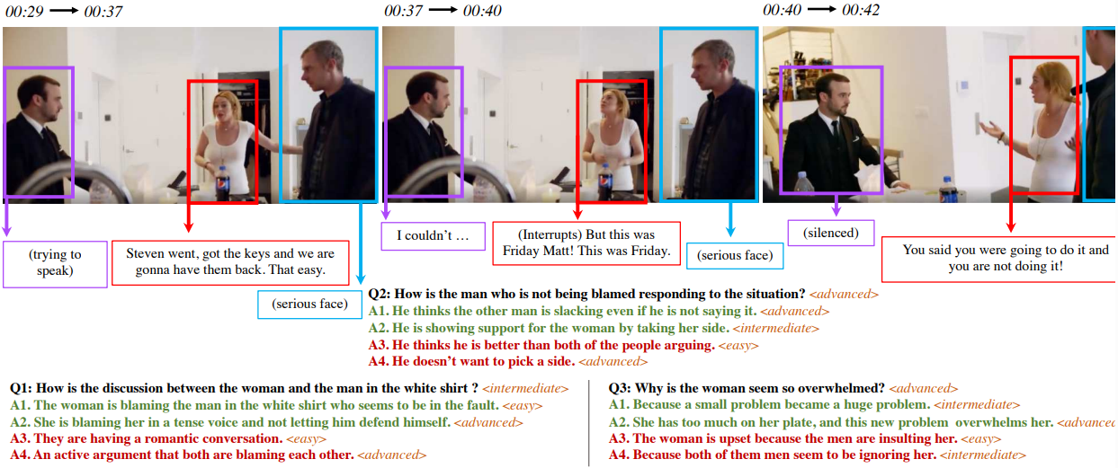
Multimodal Deep Learning Datasets
Importance of Data
Essential for the advancement of multimodal machine learning.
Example Datasets
COCO-Captions,
VQA, CMU-MOSEI,
Social-IQ,
Kinetics 400/600/700.
Dataset Variety: Includes images, text, audio and video content.
Applications: Used for tasks like action recognition, emotion analysis and scene understanding.

Slide 32
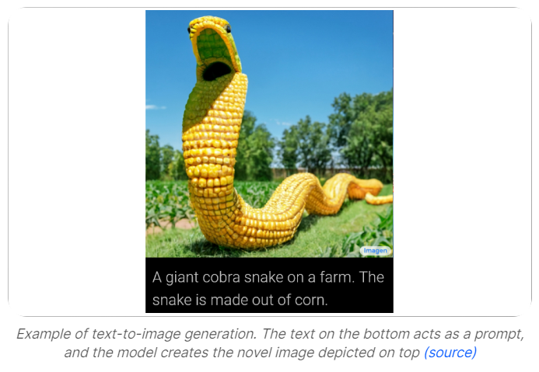
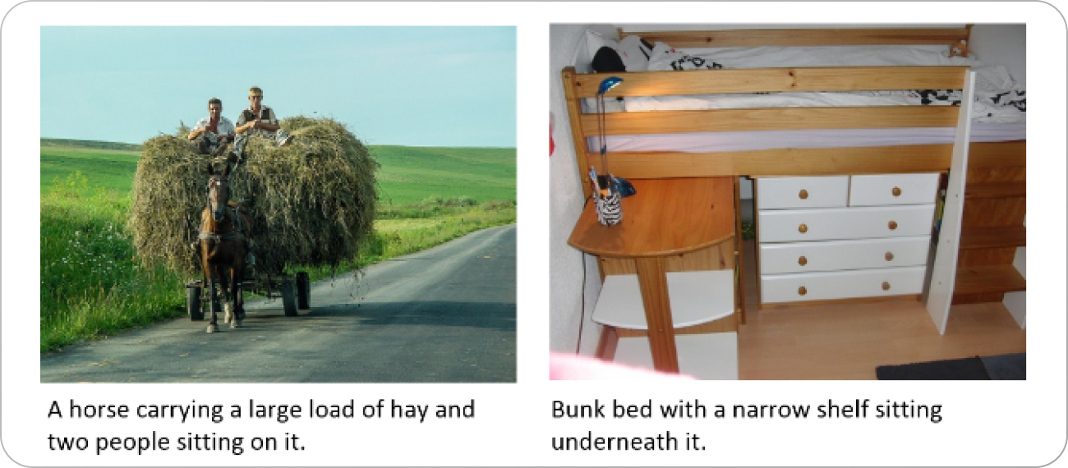
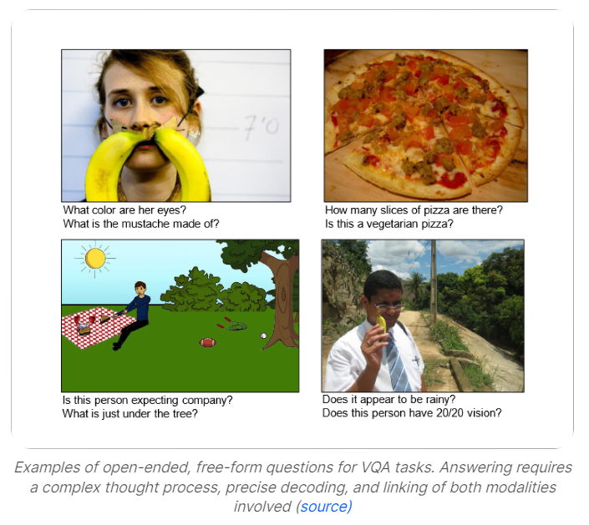
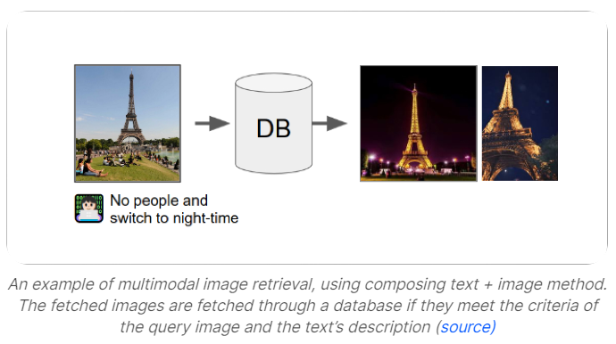
Multimodal Deep Learning Applications
Image Captioning - Generating text descriptions for images.
Image Retrieval - Finding relevant images using multimodal queries.
Text-to-Image Generation - Creating images from textual descriptions.
Visual Question Answering - Answering questions based on visual content.
Emotion Recognition - Interpreting emotions using combined modalities.
Sentiment analysis from combined text and audio data.
Autonomous vehicles - Pprocess visual, radar and LIDAR data simultaneously.

Slide 33
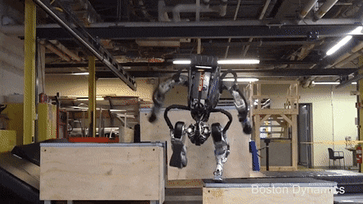

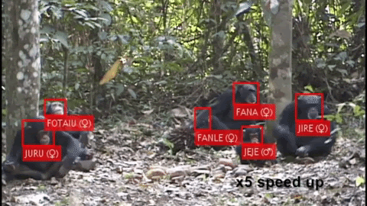
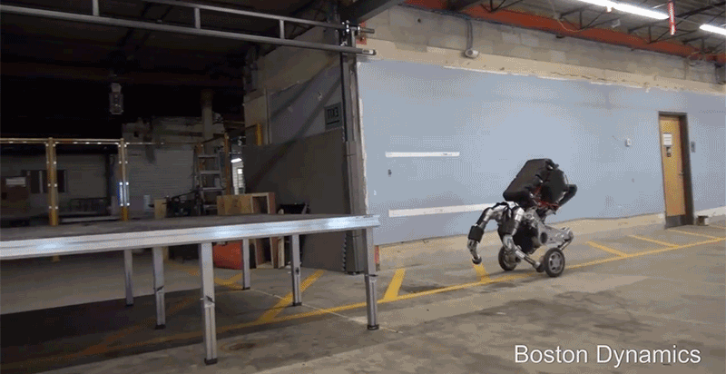
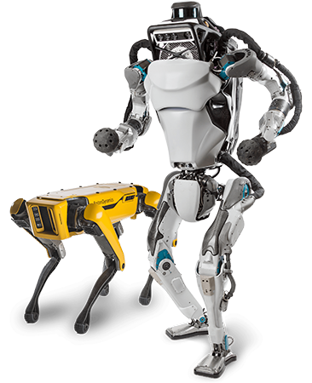
Agbots Want Jobs Americans Don't
Chimp Recognition
AI is capable of picking faces out of the crowd even if that crowd is squabbling over bananas in a jungle.

Slide 34
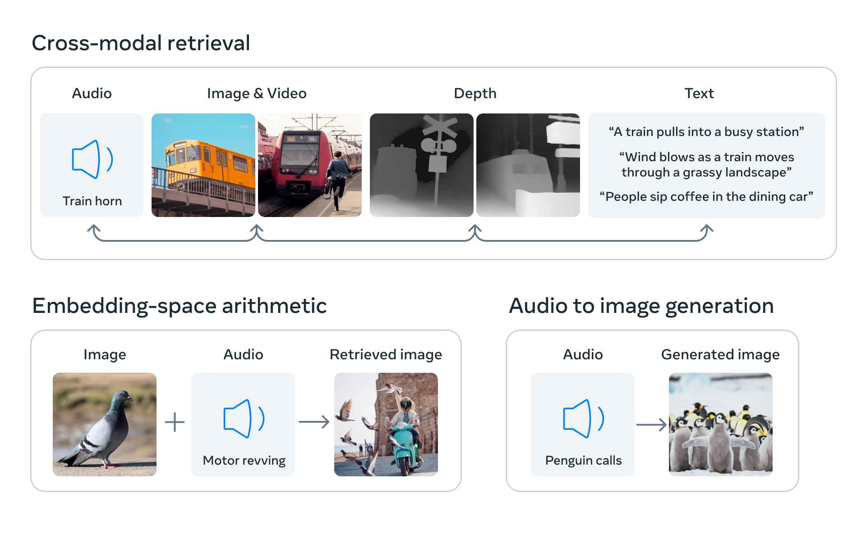
Cross-modal AI
Definition:
Cross-modal AI refers to the ability of a system to translate or understand information from one modality in the context of another. It involves mapping data from one mode to a corresponding representation in another mode.

Slide 35
Cross-modal AI
Purpose:
The goal is to enable a system to make inferences or retrieve information across different types of data. A cross-modal AI system can generate a textual description of an image (image-to-text) or retrieve relevant images based on a text query (text-to-image)

Slide 36
Cross-modal AI
Complexity:
Such systems often rely on finding a common representational space where data from different modalities can be compared or related to each other.

Slide 37
Cross-modal AI
Common applications include:
image and video retrieval based on text descriptions,
generating soundscapes from visual data,
synthesizing speech from text.

Slide 38
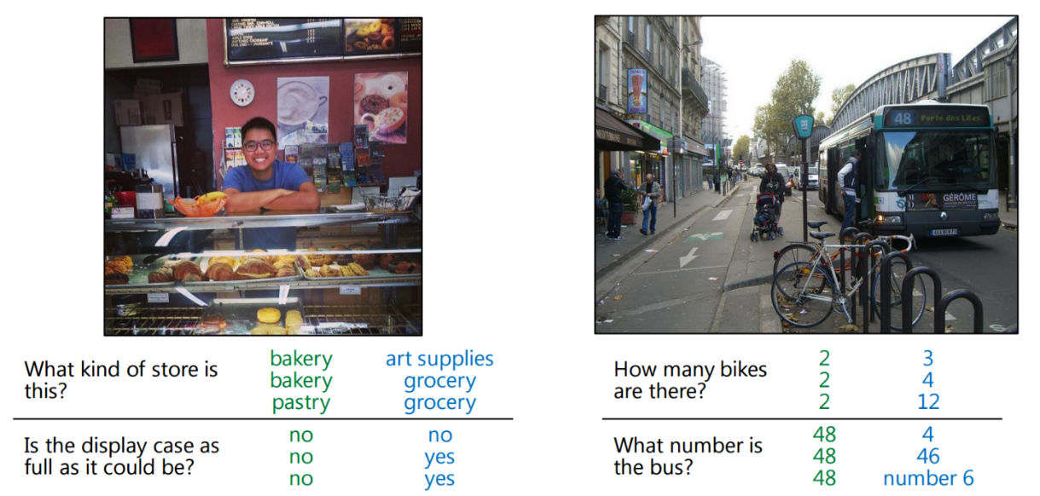
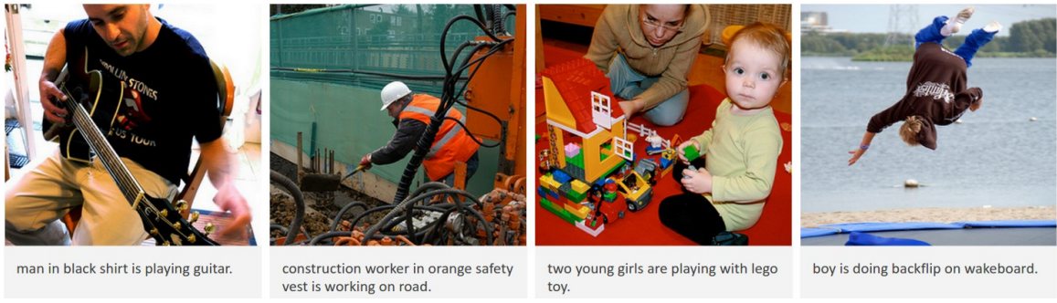
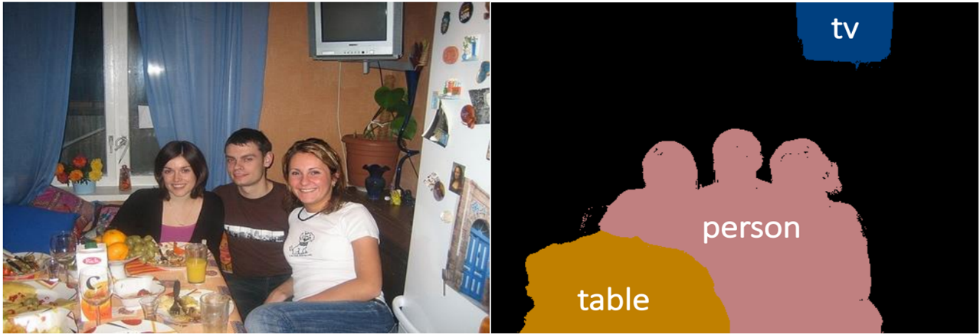
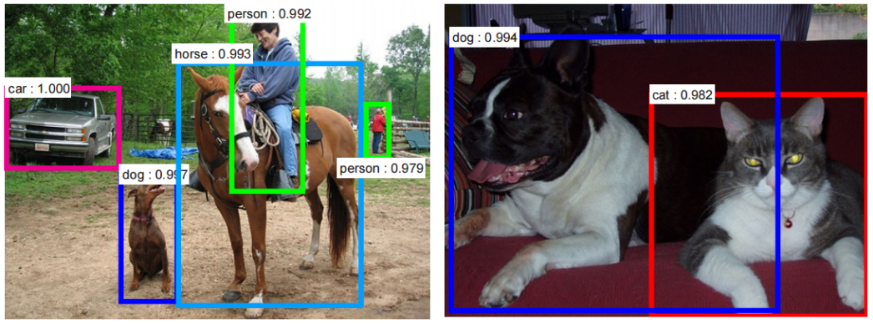
Examples
Andrej Karpathy, Li Fei-Fei, Deep Visual-Semantic Alignments for Generating Image Description, CVPR, 2015
Shaoqing Ren, Kaiming He, Ross Girshick, Jian Sun, Faster R-CNN: Towards Real-Time Object Detection with Region Proposal Networks, arXiv:1506.01497.
Shaoqing Ren, Kaiming He, Ross Girshick, Jian Sun, Faster R-CNN: Towards Real-Time Object Detection with Region Proposal Networks, arXiv:1506.01497.

Slide 39

A computer vision system is helping to keep runners with impaired vision on track. A prototype smartphone app developed by Google translates camera images into audio signals. Guidelines produces sounds that indicate deviations from lines painted on a path, enabling people to correct their course without using their eyes.

Slide 40
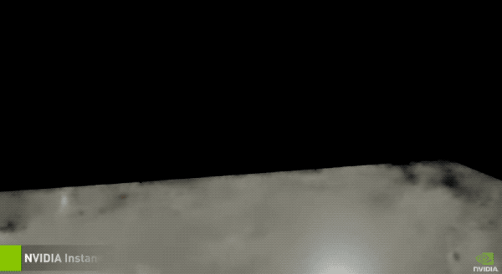
NVIDIA's NeRF AI Can Turn 2D Images Into a 3D Scene in "Tens of Milliseconds"

Slide 41

DALL·E 2 can create original, realistic images and art from a text description.
It can combine concepts, attributes, and styles.
TEXT DESCRIPTION:
A bowl of soup as a planet in the universe as a 1960s poster.
https://openai.com/dall-e-2/

Slide 42
Cross-modal and Multimodal Key Differences
Scope of Data Handling:
Multimodal: Integrates and processes data from multiple modalities simultaneously.
Cross-modal: Focuses on translating or relating information between different modalities.
Purpose and Function:
Multimodal: Aims to provide a more comprehensive understanding by combining multiple data types.
Cross-modal: Aims to bridge the gap between different data types, allowing for translations or connections between them.
Applications:
Multimodal: Used in systems that require simultaneous interpretation of different data types, like in advanced AI assistants or autonomous vehicles.
Cross-modal: Used in applications like search engines that retrieve images based on text queries, or AI tools that create textual descriptions for images.

Slide 43
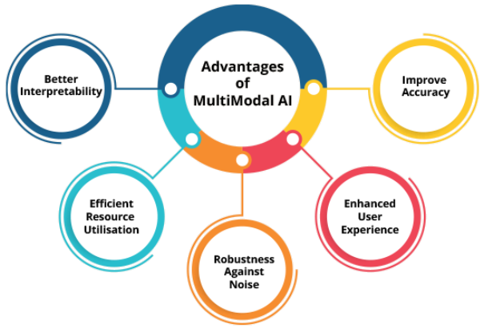
Benefits of Multimodal Approach
1. Enhanced Accuracy
Combines text, image and audio for a richer data analysis.
Improves decision-making in complex tasks like customer sentiment analysis.
2. Improved User Interaction
Offers voice, text and gesture input options.
Increases convenience and accessibility in applications like virtual assistants.
3. Greater Robustness
Resilient to noise and data variability.
Maintains performance in challenging conditions (noisy speech recognition).
4. Resource Efficiency
Focuses on relevant data from each modality.
Reduces unnecessary processing, especially in tasks like social media analysis.
5. Enhanced Interpretability
Provides multiple data perspectives for explanation.

Slide 44
Computing Power

Slide 45
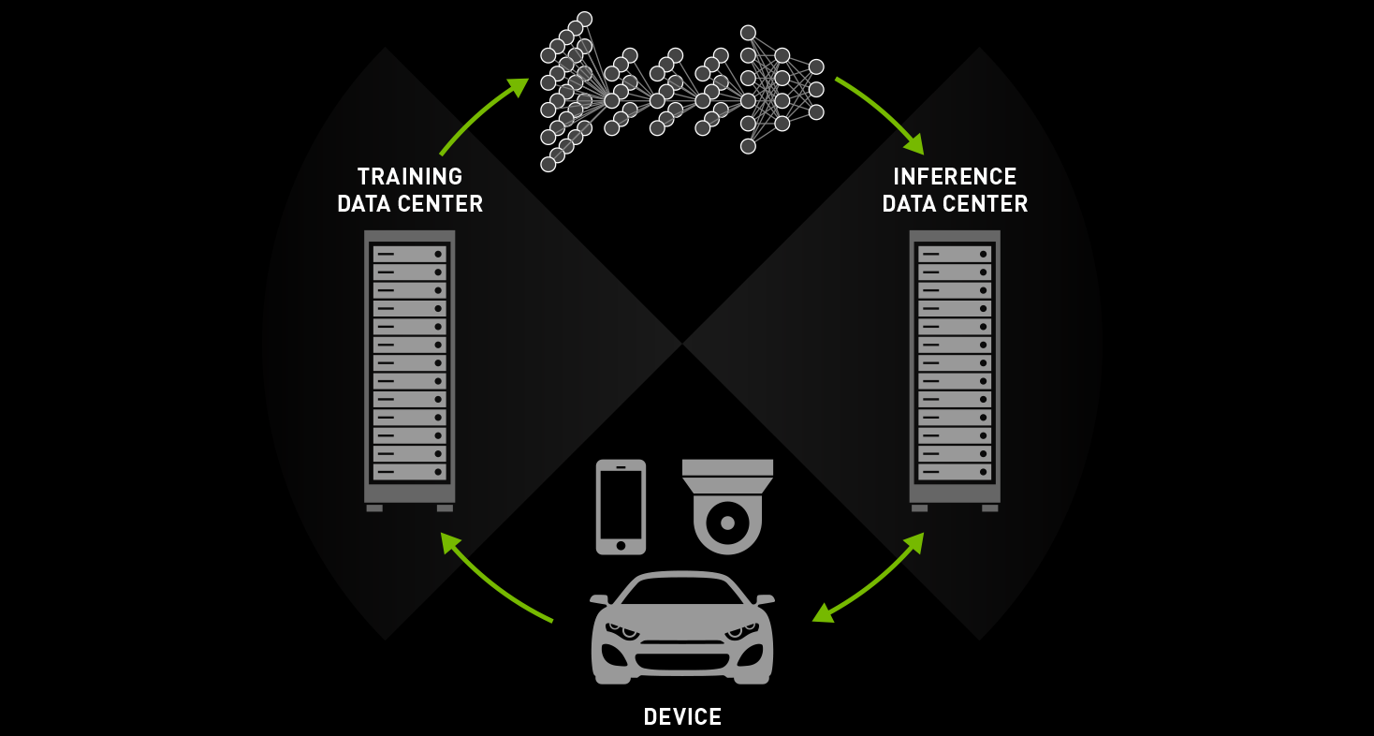
Processing Power
On-premises/Data centers
Nvidia, HP
Cloud computing
AWS, MS Azure, Google GCP, IBM
Single Board Computers
Google Coral, Raspberry Pie, Nvidia Jetson, Intel Nano

Slide 46
Training and Deployment Challenges
Efficient and Effective Implementation:
Key challenge in AI model deployment.
Options:
Cloud computing, edge AI, on-premise computing, single board computers.
Factors:
Cost, performance, scalability, security, latency.
Scale: Involves neural networks with millions/billions of parameters.
Demands: High computer power and processing requirements.

Slide 47
Training and Deployment Challenges - On-Premise
Dedicated Servers/Clusters
Owned and managed by organizations.
Advantages
Control, security, independence from internet connectivity.
Disadvantages
Higher initial investment, maintenance costs, limited flexibility.

Slide 48
Training and Deployment Challenges - Cloud
High-Performance Resources
GPUs, TPUs for data handling and computation.
Advantages
Accessibility to advanced tools and frameworks.
Drawbacks
Cost, internet dependency, potential security/privacy issues.
Cloud computing made AI cheaper and more practical.

Slide 49
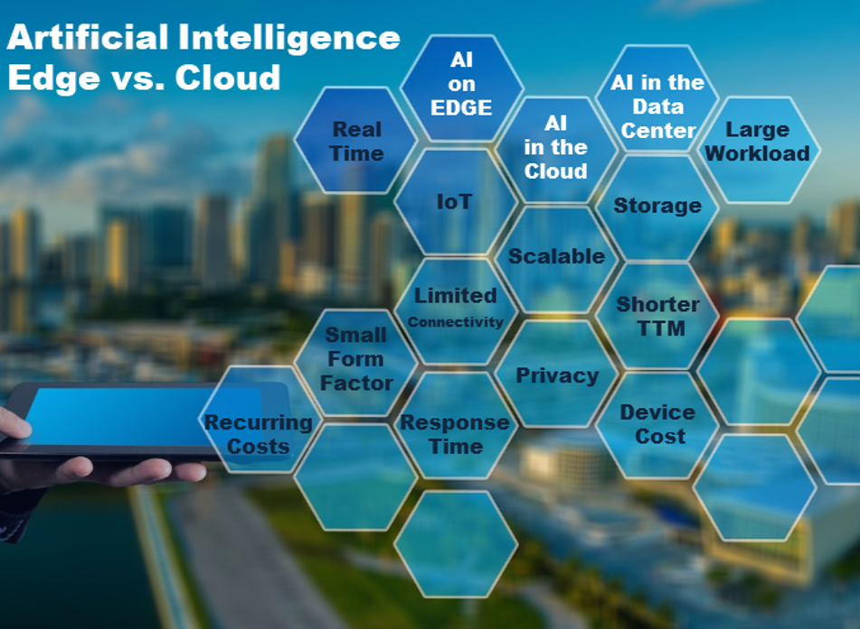
Cloud based solutions – benefits?
Simple integration
Continually learning
Fully managed
Batch & real-time analysis
Low cost
Security & identity
AI on the embedded device?
AI services deployed in remote, highly-scalable, ultra-fast computers in the cloud or data centers?
Notes:
Well, the answer is not that straight forward and depends on many factors. Some of them have been highlighted in the infographic above. Nevertheless it is usually a trade-off between required computing power, expected cost of the device, time to market vs. connectivity and bandwidth capabilities, needed response time, privacy and security concerns or even accepted level of recurring cost. Based on our experience, however, on-device deployments have usually been preferred for the following scenarios:
Simple integration
Amazon Rekognition makes it easy to add visual analysis features to your application with easy to use APIs that don't require any machine learning expertise.
Continually learning
The service is continually trained on new data to expand its ability to recognize objects, scenes, and activities to improve its ability to accurately recognize.
Fully managed
Amazon Rekognition provides consistent response times regardless of the volume of requests you make. Your application latency remains consistent, even as your request volume increases to tens of millions of requests.
Batch & real-time analysis
You can run real-time analysis on video from Amazon Kinesis Video Streams, analyze images as they are uploaded to Amazon S3. For large jobs, use AWS Batch to analyze thousands of images or videos.
Low cost
With Amazon Rekognition, you only pay for the number of images, or minutes of video, you analyze and the face data you store for facial recognition. There are no minimum fees or upfront commitments.
Security & identity
You can easily integrate face-based user verification into new or existing applications. This is a simple process that requires the use of just one API.

Slide 50
Training and Deployment Challenges – Edge AI
Local Device Deployment (smartphones, tablets, cameras, sensors)
Benefits:
Lower cost,
Reduced latency,
Faster data processing,
Enhanced security and privacy,
Data and models stored locally.
Limitations:
Lower performance,
Limited computing power and memory,
Scalability issues - restricted storage capacity and battery life,
Complexity in optimization - need for device-specific model tuning.

Slide 51
Training and Deployment Challenges – Single Board Computers
Devices
Raspberry Pi, Arduino, Jetson Nano.
Benefits
Affordability, portability, creative potential.
Drawbacks
Limited computing power, compatibility issues, stability concerns.

Slide 52
Training and Deployment Challenges - Suggestions
Tailored Solution Needed - No universal answer for all projects.
Decision Factors - Cost, performance, scalability, security, latency.
Project-Specific Evaluation - Essential to determine the most suitable approach.

Slide 53

Cloud vs Edge
Scalability needs
Near-real-time AI experience needs
Round-trip latencies concerns
Intermittent connectivity related issues
Reduction of the bandwidth costs
Privacy and security concerns
Decentralization of AI services makes it easier to expand the IoT ecosystems
Mainly enabled by the modern low power, high performance, small form factor accelerators
Deploying AI directly on the device enables making on-the-spot decisions
As AI is deployed on-the-device, there is no need for sending the data from the device to external AI services
AI-enabled devices pre-process the data and send the results to external services vs raw data
Having AI on the device allows for sending the data to external storages selectively
Notes:
Scalability needs
Decentralization of AI services makes it easier to expand the IoT ecosystems.
Near-real-time AI experience needs
This is mainly enabled by the modern low power, high performance, small form factor accelerators.
Round-trip latencies concerns
Deploying AI directly on the device enables making on-the-spot decisions.
Intermittent connectivity related issues
As AI is deployed on-the-device, there is no need for sending the data from the device to external AI services and waiting for results.
Reduction of the bandwidth costs
AI-enabled devices pre-process the data and send the results to external services vs raw data.
Privacy and security concerns.
Data can stay locally on the device. Having AI on the device allows for sending the data to external storages selectively.
Lastly, there is no silver bullet or one fits all scenario. Final deployment strategy highly depends on many factors. Nevertheless the above are the ones we have seen at byteLAKE as the key drivers for the Edge Intelligencebecoming more and more present in all sort of applications, from industrial to consumer electronics. Anyway if you’re thinking of enhancing your products or services with Artificial Intelligence features, do contact me directly or reach out to my team at byteLAKE here: http://www.bytelake.com/en/contacts/. We are experts in the field and can advise about selecting optimal configurations, integrate proper baseline components and help build a final product on top of that.

Slide 54
Development & Implementation options

Slide 55
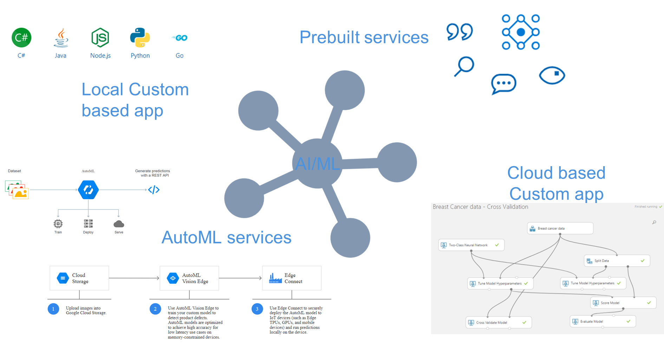
Development & Implementation options

Slide 56
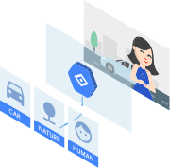


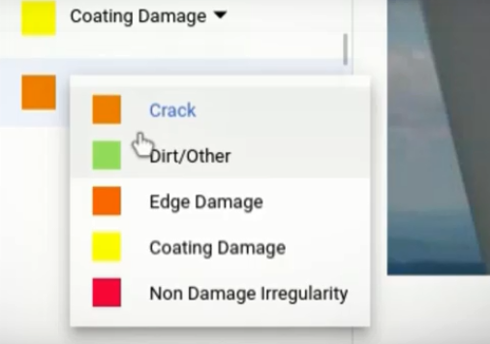
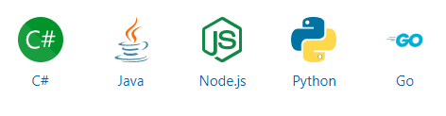
Cloud based solutions
Cognitive Services
Amazon
Google
IBM
API access
Notes:
Artificial Intelligence is booming these days. No doubt about that. We have seen exponential growth in almost all fields related to AI over the past few years: number of startups, amount of investments, number of research papers or even expected revenues driven by AI-powered enterprise applications. All of these have been enabled mainly by 3 factors
Cloud AI services provide cognitive services/capacitites over the Internet. They allow client or client applications to upload structured or unstructured data and based on cloud based processing receive a cognitive response.
Train custom machine learning models
Cloud AutoML is a suite of machine learning products that enables developers with limited machine learning expertise to train high-quality models specific to their business needs. It relies on Google’s state-of-the-art transfer learning and neural architecture search technology.
Custom models
Train custom machine learning models that are specific to your business needs, with minimum effort and machine learning expertise.
Powered by Google’s AutoML and transfer learning
Leverages Google state-of-the-art AutoML and transfer learning technology to produce high-quality models.
Fully integrated
Cloud AutoML is fully integrated with other Google Cloud services, giving you a consistent way to access the entire Google Cloud service line, including storing your training data in Cloud Storage. To generate a prediction on your trained model, simply use the existing Vision API by adding a parameter for your custom model or use Cloud ML Engine’s online prediction service.
Integration with data labeling service.
If you have images but no labels yet, an in-house Google team will review your custom instructions and classify your images accordingly. You’ll get high-quality training data while your data remains private. You can also use the human-labeled data seamlessly to train a custom model. Available for AutoML Vision only.
The Computer Vision API provides state-of-the-art algorithms to process images and return information. For example, it can be used to determine if an image contains mature content, or it can be used to find all the faces in an image. It also has other features like estimating dominant and accent colors, categorizing the content of images, and describing an image with complete English sentences. Additionally, it can also intelligently generate images thumbnails for displaying large images effectively.
What is Amazon Rekognition Image?
Rekognition Image is a deep learning powered image recognition service that detects objects, scenes, and faces; extracts text; recognizes celebrities; and identifies inappropriate content in images. It also allows you to search and compare faces. Rekognition Image is based on the same proven, highly scalable, deep learning technology developed by Amazon’s computer vision scientists to analyze billions of images daily for Prime Photos. The service returns a confidence score for everything it identifies so that you can make informed decisions about how you want to use the results. In addition, all detected faces are returned with bounding box coordinates, which is a rectangular frame that fully encompasses the face that can be used to locate the position of the face in the image.

Slide 57
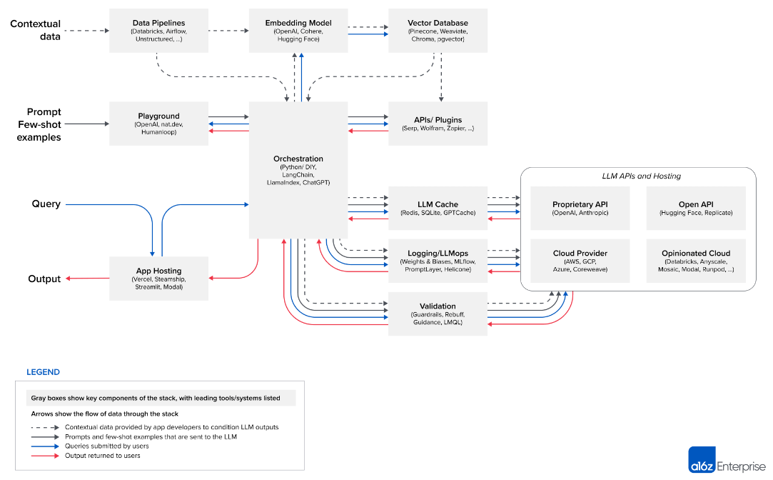
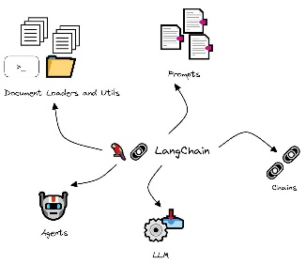
Algorithms, frameworks and APIs
https://a16z.com/

Slide 58
Algorithms, frameworks and APIs
Data pipelines | Embedding model | Vector database | Playground | Orchestration | APIs/plugins | LLM cache
Databricks | OpenAI | Pinecone | OpenAI | Langchain | Serp | Redis
Airflow | Cohere | Weaviate | nat.dev | LlamaIndex | Wolfram | SQLite
Unstructured | Hugging Face | ChromaDB | Humanloop | ChatGPT | Zapier | GPTCache
 |  | pgvector
https://a16z.com/

Slide 59
Concluding Remarks

Slide 60
Challenges and Future Directions
Scalability Concerns
Addressing the computational demands of large models.
Ensuring Robustness
Maintaining performance across varied scenarios.
Ethical Considerations
Balancing innovation with responsible use.
Fairness and Bias Mitigation
Developing unbiased and equitable AI solutions.
Trustworthy AI
Building reliable and ethical AI systems for societal benefit.

Slide 61
The Future of Integrated AI
Evolving AI Landscape
Continuous innovation in model training and application.
Broader Implications
Transforming industries with advanced data interpretation.
The Path Ahead
Exploring untapped potential in AI technology integration.

Slide 62


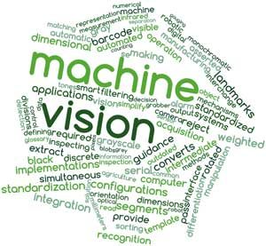
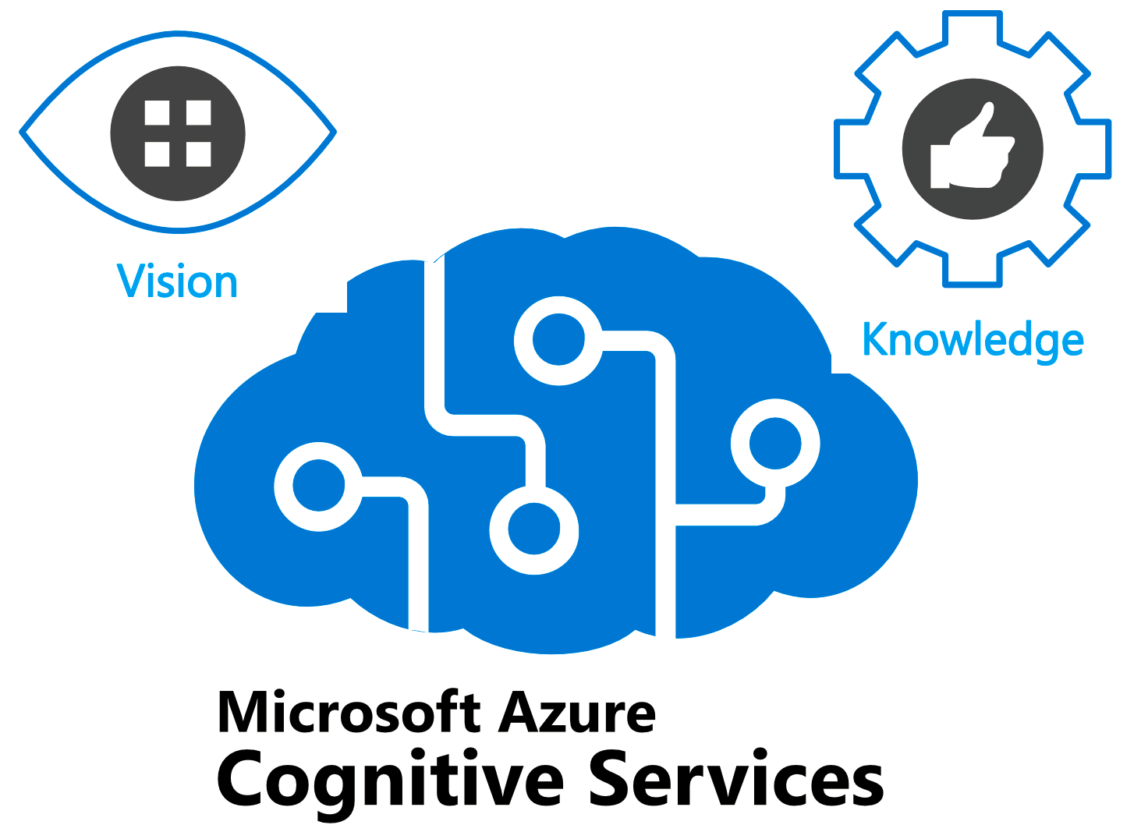



Hands on Lab

Slide 63
Discussion

Slide 64
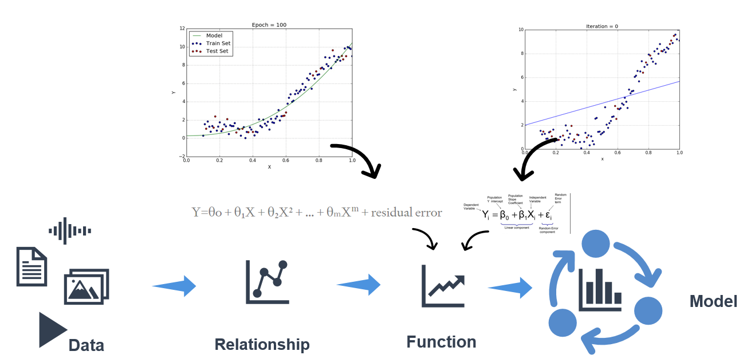
Machine Learning Model

Slide 65
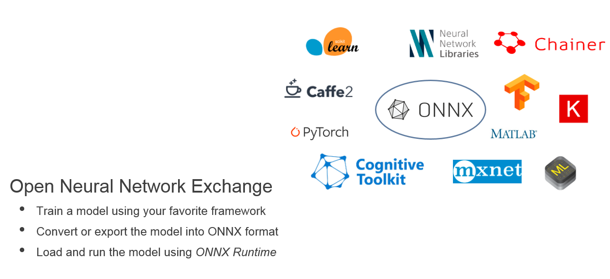
Representing ML Models

Slide 66

ML Categories

Slide 67

ONNX Community

Slide 68

Deep Learning

Slide 69

Questions?

